Slide 1
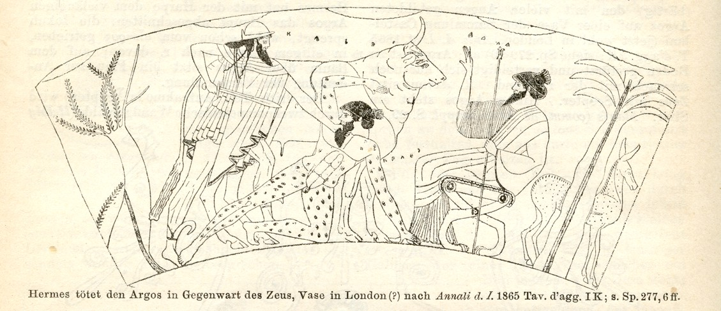
Inholland Panoptes tool ‘Can see everything’

Slide 2
Panoptes aims
Provide infrastructure for contouring studies using commercial planning systems
Automate data management
Isolate students from each others work
Provide efficient visualisation of all results
Provide innovative evaluation of results e.g.
Automated marking for quality
Automated feedback for common mistakes

Slide 3
Infrastructure Requirements
Works with any planning system
Anonymisation of input data
Students data isolated by anonymisation
Automatic detection of students work
Upload through WEB
Send over DICOM connection
Collect data in standard DICOM structure
Fast web viewer allowing up to hundreds of observers
Easy maintenance

Slide 4

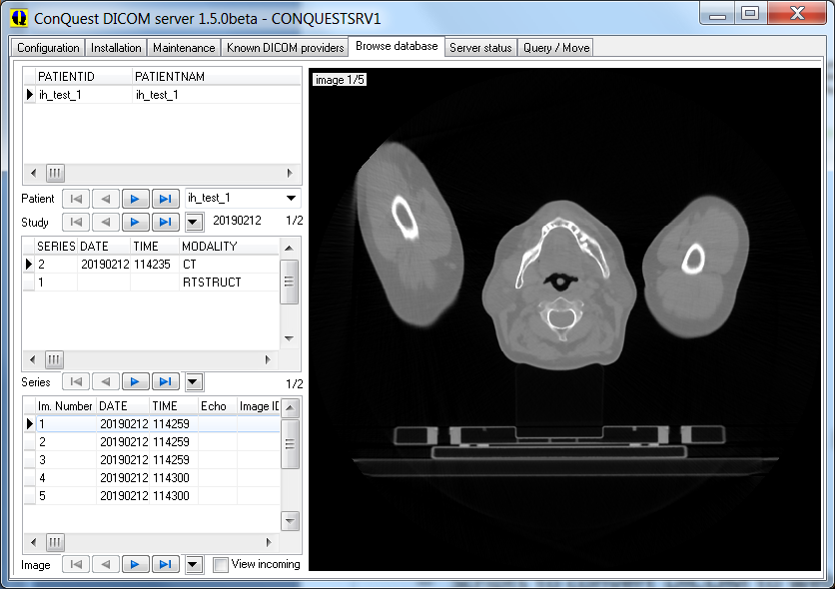
Main component used
Conquest DICOM server
Scripting based web interface
Extendible
Anonymiser
De-anonymiser
Upload and process
Database query from web
Convert DICOM data to web data
Software updater
Down/upload anonymisation table
Linux or Windows

Slide 5
DICOM server
Web server
Teacher Patient Study Series Image Student
tool tool
Module-Patient
anonymise
Student ID
Session
Viewer
Source data
Download
Upload
anonymise
CT
collate
images
Slices
Jpeg per slice
Upload
anonymise&empty
Template
Modify
Signed 3D distxfm of 1-3 GS as
png files in .5mm
RTSTRUCT
todo
Upload
Signed 3D distxfm of 1-3 masks as
png files in .5 mm
Analysis
Upload
anonymise
Gold standard
Evaluation
de-anonymise
collate
RTSTRUCT
Json per slice
RTSTRUCT
Gold standards
Session-Observers
collate
RTSTRUCT
Json per slice
RTSTRUCT
Observers

Slide 6
Modify to organize
Convert for viewing
Generic download / upload / view / control
Newweb /dgate.exe
start (control/query)
listpatients (download) wadoviewer (view)
Process_inholland
cgi-bin:
view upload control
query
Database
Files
DICOM clients
Browser
Conquest server
Web server
Teachertool
deanonymize
Images
json
htdocs:
select
view
anonymize
Vuejs & axios
Browser
Viewer
dicomserver
apache2
Table | Key | Value | Link
Patients | Patient ID | Name
Studies | Study UID | Descript. | Patient ID
Series | Series UID | Descript. | Study UID
Images | Image UID | Image ID | Series UID
UIDmods | Old UID/ID | New UID/ID | Stage
Teachertool.html
lua
viewer.html
Studentviewer.html
js, html
GUI
viewer.js
application

Slide 7
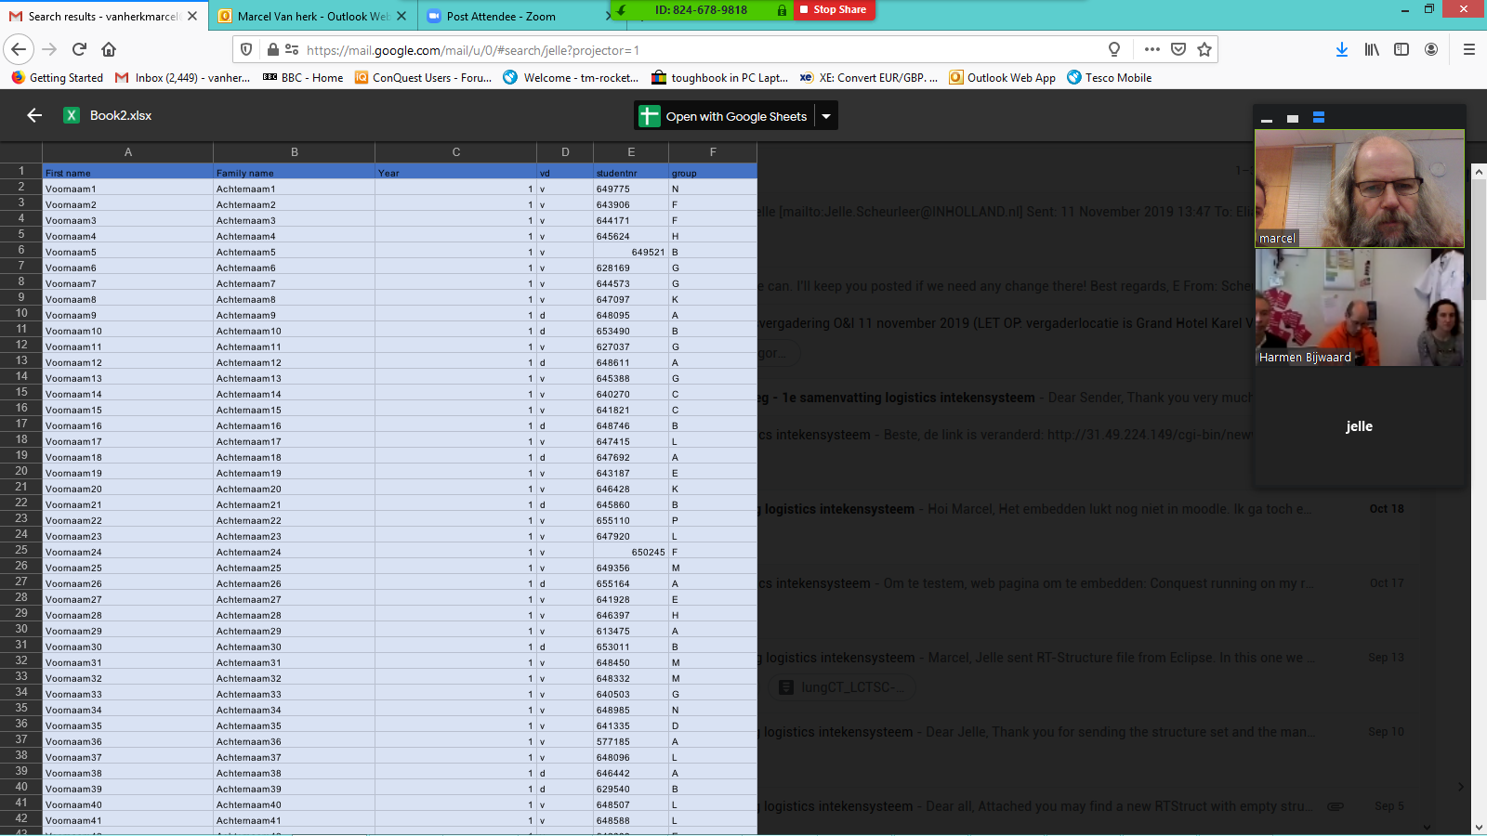

Slide 8
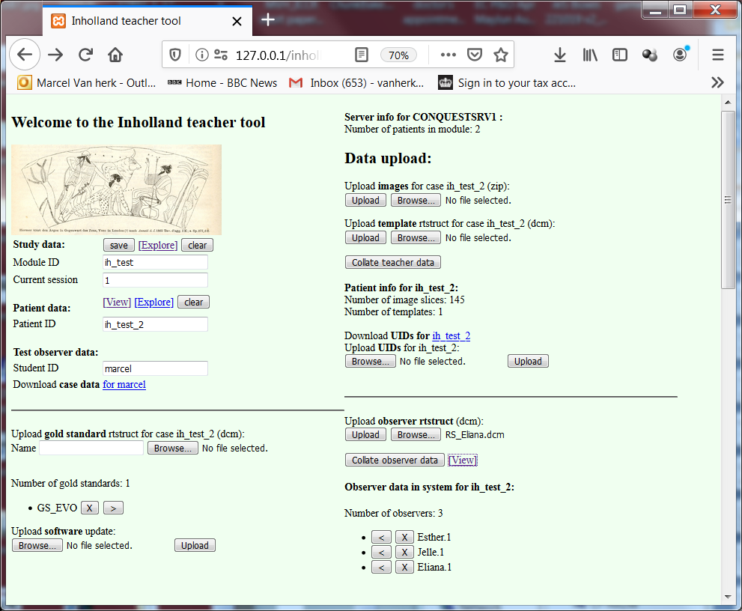
Teachertool - information
DICOM data
Patient data
Gold standards
Observers
Not yet implemented

Slide 9
Teachertool - workflow
2. Upload images
3. Upload template
5. Make web page
1. Select patient
6. Generate observers
Generate multiple
7. Load observer data
4. Upload gold standard
8. Observers to web
9. View data

Slide 10
Teachertool – extra functions
Transfer data between systems
1. Software update
Not yet implemented

Slide 11
Minimal viewer requirements
Start from teacher tool
Select study
Select patient
Move through slices
Selector for gold standard
Draw thick with different color per gold standard
Colors and structure names from template
Selectors for gold standard, structure, observer
Can select [all] for each option
Draw students with thin lines

Slide 12
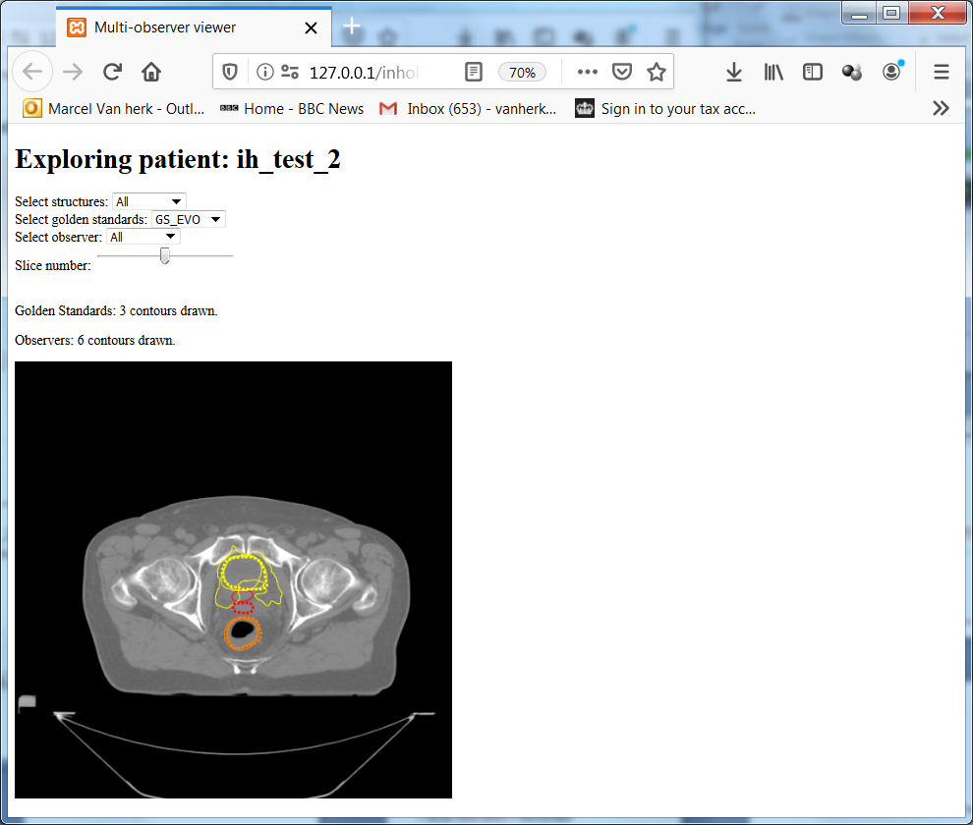
Viewer prototype
Selection to add:
Year
Group
Session
Functions to add:
Zoom
Pan
Level&Window
Identify observer
Evaluation to add:
Color with distance
% out of limit
% overlap with other ROIs
Targeted hints
….

Slide 13
Ideas for evaluation
Data:
One or more gold standards EVO.prostate
Up to 3 regions of interest rectummask
Observers
Comparison by distance distribution

Slide 14
Comparison metric: 3D distance histogram
Reference
Student
Distance (mm)
Here the student is mostly outside the reference (positive distance)

Slide 15
Directed feedback
GS prostate
Warning: delineation too close to rectum
ROI: rectummask
Rectum
If more than 2% of contour ‘prostate’ overlaps with contour ‘rectummask’ with 0 mm margin then hint “prostate overlaps with rectum”
If more than 5% of contour ‘prostate’ overlaps with contour ‘EVO.rectum’ with 4 mm margin then hint “prostate overlaps with rectum”

Slide 16
Scoring idea
Use gold standard
Score against:
Inner = gold standard – 5 mm
Outer = gold standard + 5 mm
5 mm is an example, value can be changed

Slide 17
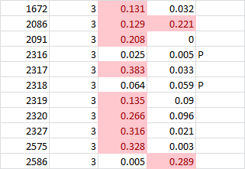
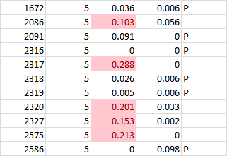
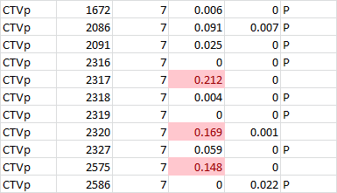
Compare against gold standard Vary fraction as well as distance
StID
Dist
FractIn
Out
StID
Dist
FractIn
Out
StID
Dist
FractIn
Out
B
C
B
A
F
A
B
F
C
F
B
Pas rate, students out of 11
Using a fraction of 0.1 (10%)
e.g.
- use 3 mm for top score 2 students A
- use 5 mm for runner up 4 students B
- use 7 mm for near fail 2 students C
- others fail 3 students fail

Slide 18
Example scoring rules
Per study / patient(?)
If more then 10% of contour prostate inside or outside goldenstandard + 7 mm then score C
If more then 10% of contour prostate inside or outside goldenstandard + 5 mm then score B
If more then 10% of contour prostate inside or outside goldenstandard + 3 mm then score A

Slide 19
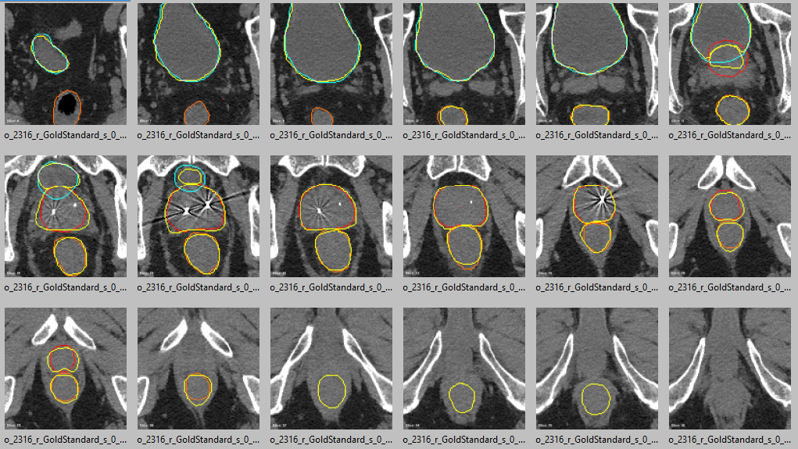
Top score - A
Prostate:
Gold Standard
Student

Slide 20
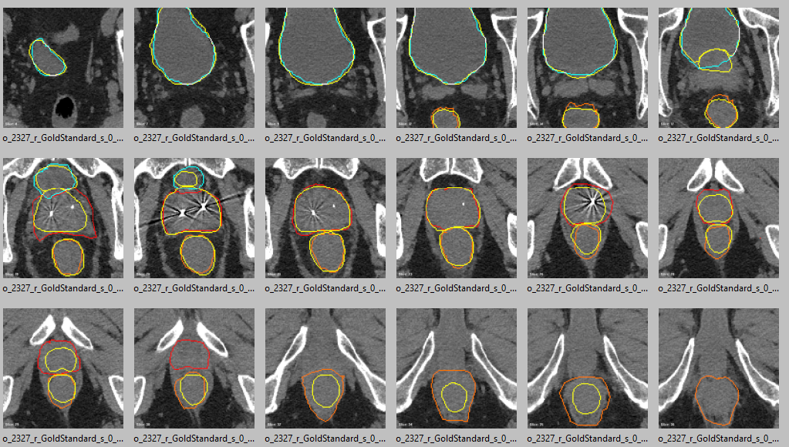
Pass - C
Prostate:
Gold Standard
Student

Slide 21
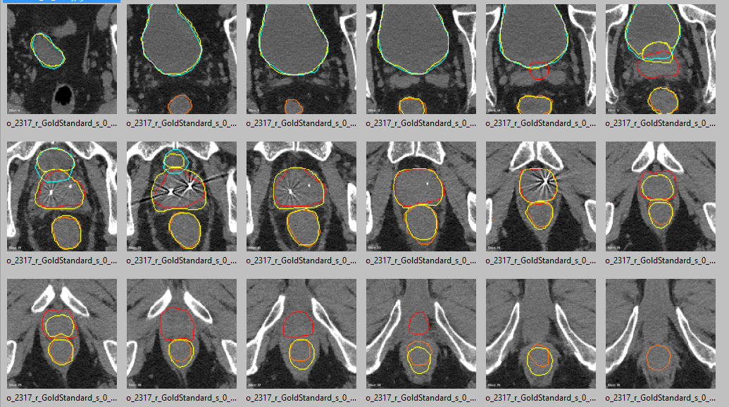
Fail
Prostate:
Gold Standard
Student

Slide 22
Next steps
More options for the viewer
Student tool (login ID)
Test server in Inholland
Link external database with extra student information
Better layout of teacher tool (with tabs)
Pilot test
Distance to agreement module
Rule module
Pilot test
Development and testing of the rules for hints and scoring

Slide 23
The END!

Slide 24
Install on windows
Install xampp in c:\xampp
Enable and start apache2 service
Make folder c:\temp
Unzip conquest dicom server as c:\dicomserver
Run conquestdicomserver.exe
Save configuration
(Re-)initialize database
Keep GUI open
Go into webserver folder
Copy contents of cgi-bin and htdocs into same folders in c:\xampp

Slide 25
Load data
Open \\127.0.0.1\inholland\teachertool.html
Set patient to ih_test_2
Upload ih_test.ih_test_2.sql to UIDs (response 1)
Upload CTs.zip as scan (response processed and loaded)
Upload RS1.2.752… as template (idem)
Upload RS1.2.752… as goldstandard name EVO (idem)
Upload ihtest2Esther1_StrctrSets.dcm etc as observer (idem)
Collate teacher data
Collate observer data
Viewer

Slide 26
Student interface
Studentnummer Studynummer
PatientNummer status download/push upload
PatientNummer status download/push upload
PatientNummer status download/push upload
PatientNummer status download/push upload

Slide 27
Schema
RTP
Mask structures
Database
(sqlite)
Conquest gateway (cgi)
Conquest server(dicom)
Webserver
(apache, xampp)
dicom
Monaco RTP
Evaluation/visualualization scripts
upload
admin
download
Teacher tool
Student tool
Evaluation/visualization tool
student
Evaluation/visualization tool
teacher

Slide 28
Engels
Need delete ?
Need change?
study
Bekken
patient#
1
#sessions
2
New patient
Upload image data
Upload contour template
Upload gold standard
zip
dcm
Upload gold standard
dcm
Reduce slices by 1/
2
Need slices of interest selection ?
Mark slices of interest in template: Y/N
Save
study
Bekken
Current session: 1/2/any
Add class password: (can be empty)
Create list of observer passwords
Uploads list of student IDs, includes class and group and password
Save

Slide 29
Components
Restful database
Inholland_studies
studyName varchar(64),
description varchar(64),
nphases integer,
activephase integer,
Inholland_patients
patientID varchar(64),
studyID varchar(64),
templateUID varchar(64),
goldenStandardUIDs varchar(640),
Inholland_observers
studentNumber varchar(64),
Password varchar(64),
Group varchar(64),
Profession varchar(64),
Inholland_delineations
studentNumber varchar(64)
PatientID
studyInstanceUID varchar(64) (study bevat CT en template)

Slide 30
Steps
Selecting study will create or read study
Contains id, name, description, nphases, activephase
Selecting patient will create or read patient
Contains study id, description, studyuid of scans, sop of template, sops of ground truth(s)
Uploading scan will update patient db
Uploading template will update patient db
Uploading GT will update patient DB
Downloading patient will create observer
Contains obs id,

Slide 31
student 682169 = fqr884
Etc
Student# kan ook letters hebben

Slide 32
Class dropdown
Student dropdown/edit -- ID
Student → select study → select patient → (select session) → Password?
download CT + template
Upload contours

Slide 33
Data processing
Load CT
Upload zip
Unzip
Anonymize with stage study.patient
Set PatientID to given value
Study description = ‘Source data’
Series description = CT
Note: make backup of relevant UIDmods

Slide 34
Load template
Anonymize with stage study.patient
Set PatientID to given value
Process with ‘template’ fuction in
lua/process_inholland.lua ('+patient+'|'+study+'|template|'+session+')'“
Study Description = 'Source data‘
Series Description = 'Template‘
Remove contours (and ununused slices)
Copy into ‘Template’ series if exists, otherwise create
Note: make backup of relevant UIDmods

Slide 35
Load gold standard
Anonymize with stage study.patient
Set PatientID to given value
Process with ‘goldstandard’ fuction in
lua/process_inholland.lua ('+patient+'|'+study+'|goldstandard|'+session+'|'+gsname')'“
StudyDescription = 'Analysis'
SeriesDescription = 'Gold standard‘
ImageID = gold standard name
Copy into ‘Gold standard’ series if exists, otherwise create
Note: make backup of relevant UIDmods

Slide 36
Download CT & template for delineation
Anonymize with stage study.patient.observer.session
Set new PatientID to given PatientID.Observer.Session
(Note: cannot use ‘.’ in PatientID)
Uses link:
Dgate?mode=listpatients&parameter=zipanonymized
&item=patient+studyuid
&newid=patient+‘.'+observer+‘.’+session
&stage=study+‘.'+patient+‘.'+observer+‘.'+session
Note: make backup of relevant UIDmods

Slide 37
Upload observer RTSTRUCT
Deanonymize with stage *
Save PatientID in 9999,9000
(finds stage based on unique Patient ID)
Process with ‘observer’ fuction in
lua/process_inholland.lua ('+patient+'|'+study+'|’+observer+’|'+session)'“
StudyDescription = 'Analysis‘
SeriesDescription = ‘Observers'
Add to series ‘Observers‘ if exists otherwise create
ImageID = observername.session (taken from 9999,9000)
StructureSetLabel = observername.session (taken from 9999,9000)

Slide 38
Files for the viewer app
CT/sliceinfo.json: list of data per image slice with:
UID, slice location, image position, image orientation, pixel size
CT/UID.jpg: jpeg with CT slice pixel range -1024..1024 HU
GS/UID.json: collated contours for this slice with:
UID
Selectors (fow now): structure name, observer, session
Color = RGB
Contours = Array of array of xyz triplets
GS/observer.json
All structures over all slices for this observer
Mostly suitable for student viewer
Student viewer can trigger conversion for self if needed
Observers/UID.json and Observers/observer.json
This is all sessions together →split

Slide 39
Installation notes
Windows 10
XAMPP 7.4.4.1
All defaults
C:\xampp
Firewall allow access (ports 80, 443)
Control panel - start apache
Check 127.0.0.1

Slide 40
Dicom server conquest150beta2 (Github)
Unzip to e.g. conquest150beta2
Conquestdicomserver
Firewall allow access (port 104)
Save settings
Regen
Copy process_inholland.lua to lua folder

Slide 41
Webserver
Copy dicom/cgi-bin contents to xampp/cgi-bin
Copy dicom/htdocs contents to xampp/htdocs
Copy teachertool.html, vue, axios to xampp/htdocs/inholland
Try: http://127.0.0.1/cgibin/newweb/dgate.exe

Slide 42
Web viewer
Select module & patient
Access student database
Choose contours for:
Individual student / all students
Individual session / all sessions
Individual cohort_year / all cohort_years
Individual study_year / all study_years

Slide 43
Components
Conquest DICOM server with update
Added web scripted add/modification of objects
E.g. Add CT
Change PatientID to inholland_bekken_1
Write StudyInstanceUID to study database; via REST interface
E.g. Add RTSTRUCT as template – naam, kleur, aantal
clear contents to create template
change PatientID to inholland_bekken_1
Write SOP to patient database ; via REST interface
E.g. Add RTSTRUCT as ground truth
Change PatientID to inholland_bekken_1
Write SOP to patient database ; via REST interface

Slide 44
Configure teachertool
Find serverip
Change with IP address of dicom server
(must be domainname, or just 127.0.0.1 or blank)

Slide 45
Todo:
Add session to collated output files for observers
Add function to add original RTSTRUCT as observer (not gold standard)
Backup anonymization table at critical steps
Test template
Make specs of computer/dicom server
Convert time ~1s per RTSTRUCT
Windows 2012R2
SQL server, eg. MySQL, Postgres (, SQLserver)
Apache webserver (, IIS)
SELECT * from myTable INTO OUTFILE '/tmp/querydump.csv'
FIELDS TERMINATED BY ','
ENCLOSED BY '"'
LINES TERMINATED BY '\n'

Slide 46
Suggested server specifications
Windows server 2012R2
8GB RAM
Core I5 2.6GHz or better
512 GB SSD drive, with 400GB free space
Backup on other server
Daily backup of database
XAMPP as webserver/database server

